Slide 1
Working In A Fishbowl: Ethics for Airport Professionals
PETER J. KIRSCH
June 4, 2023

Slide 2
Peter J. Kirsch, Esq. Kaplan Kirsch & Rockwell
35+ years in the airport industry
Represents airports on topics such as land use, regulatory and environmental issues related to airport operations and development
Advises on federal legislation and regulations and airport finance issues.
Co-editor of Airport Law Desk Reference, author of numerous Transportation Research Board publications

Slide 3
Today’s Presentation
Brief summary of professional ethics and codes of conduct
Key questions to consider
Case study examples

Slide 4
Each profession has its own
ETHICS AND CODE OF CONDUCT
. . . but there are common themes

Slide 5
Professional Engineer Ethics (paraphrased)
In order to safeguard the life, health , property and welfare of the public:
The engineer shall conscientiously avoid conflicts of interest with the client or employer
The engineer shall promptly inform the client or employer of any interest or association which could influence their judgment
The engineer shall not accept compensation, financial or otherwise, from more than one party for services on the same project, unless the circumstances are fully disclosed and agreed to by all interested parties.
Integrity: The engineer is obligated to act with complete integrity in professional matters for each client or employer as a faithful agent; shall be honest and impartial, and shall serve the public, client and employer with devotion.
Responsibility: Undertake assignments only when qualified by training an experience;
Be complexly objective in any report, statement or testimony and include all pertinent information
Express an opinion as a technical expert only when founded upon adequate knowledge of the facts, technical competence in the subject matter and honest conviction of the accuracy.

Slide 6
Professional Planners - Code of Ethics and Professional Conduct (AICP) (paraphrased)
Planner’s Responsibility to the Public
A planner’s primary obligation is to serve the public interest. While the definition of the public interest is formulated through continuous debate, a planner owes allegiance to a conscientiously attained concept of the public interest.
Planner’s Responsibility to Clients and Employers
A planner owes diligent, creative, independent, and competent performance of work in pursuit of the client’s or employer’s interest. Such performance should be consistent with the planner’s faithful service to the public interest.
Planners’ Responsibility to the Profession and to Colleagues
A planner should contribute to the development of the profession by improving knowledge and techniques, making work relevant to solutions of community problems, and increasing public understanding of planning activities. A planner should treat fairly the professional views of qualified colleagues and members of other professions.
Planner’s Self-Responsibility
A planner should strive for high standards of professional integrity, proficiency, and knowledge.

Slide 7
AAAE Code of Ethics
As a professional airport executive in the performance of my duties and professional responsibilities, I pledge to --
. . .
Be dedicated to the highest ideals of honor and integrity in all public and personal relationships in order to earn and retain the respect and confidence of public officials, employees, and the general public.
. . .
Neither seek nor accept any favor or gift from persons or firms under which circumstances could be reasonably inferred that the favor would influence or compromise the executive or governing body.
. . .
Recognize that elected and/or appointed officials are responsible for the establishment of airport policies and that policy execution is the responsibility of the airport executive.

Slide 8
Attorney Code of Ethics (summary)
Each state has it own Code of Ethics, but most follow the American Bar Association (ABA) Model Rules of Professional Conduct.
Many complex ethical obligations but focus is on confidentiality, loyalty to the client, and independence.
Lawyers’ relationship with planners, engineers, and other consultants is dictated by the client

Slide 9
Key Themes Across the Professions
Responsibility to the:
Public, client, employer, and profession
Identify conflicts of interest
Maintain level of integrity

Slide 10
Key considerations
Confidentiality
Who is the client?
What is your professional role?

Slide 11
CONFIDENTIALITY

Slide 12
ABA Model Rule 1.6: Confidentiality
A lawyer shall not reveal information relating to the representation of a client unless
The client gives informed consent,
The disclosure is impliedly authorized to carry out the representation, or
The disclosure is permitted by [an exception].
Exceptions:
To comply with a law or court order
To prevent death or bodily harm
To prevent client from committing certain crimes or frauds
To prevent, mitigate, or rectify injuries to certain financial or property interests
Other specific instances in Model Rule

Slide 13
What is confidential?
Ask the client
Check with local, state laws (including open records and open meetings laws)
Consider professional definitions

Slide 14
What is confidential?
Sensitive Security Information (SSI)
May only be disclosed to covered persons with need to know
Lawyer representing airport sponsor may have need to know to provide advice to a covered person
Duty to store and handle information to prevent unauthorized access and disclosure
Confidential
Legally Privileged
SSI

Slide 15
Other confidentiality obligations
Government ethics rules
Health Insurance Portability and Accountability Act of 1996 (HIPAA)
Personally Identifiable Information (5 U.S.C. § 552a)
Proprietary commercial/business information
Specific state laws on security information, law enforcement information, information received in confidence

Slide 16
WHO IS THE CLIENT ?

Slide 17
ABA Model Rule 1.13 Organization as a Client
(a) A lawyer employed or retained by an organization represents the organization acting through its duly authorized constituents.
Montana Bar Ethics Committee: “The attorney must proceed as is reasonably necessary in the best interest of the organization and owes a duty of confidentiality to the agency as a whole, not to its individual members.”
(g) A lawyer representing an organization may also represent any of its directors, officers, employees, members, shareholders or other constituents, subject to the provisions of Rule 1.7.

Slide 18
ABA Model Rule 1.13, Comment 9
…Defining precisely the identity of the client and prescribing the resulting obligations of such lawyers may be more difficult in the government context and is a matter beyond the scope of these Rules. Although in some circumstances the client may be a specific agency, it may also be a branch of government, such as the executive branch, or the government as a whole.

Slide 19
Most states define the client as the specific agency that employs the lawyer
DC Code of Ethics 1.6(k): The client of the government lawyer is the agency that employs the lawyer unless expressly provided to the contrary by appropriate law, regulation, or order.

Slide 20
WHAT IS YOUR PROFESSIONAL ROLE?

Slide 21
Understanding your role
Paid professional
Contracted for your services by the client
Industry professional
Not under contract but asked for your “opinion”
Trusted advisor
May be contractually obligated or not, outside of your “professional capacity”
Friend at a “party”
Other

Slide 22
CASE STUDIES

Slide 23
Case Study #1
You are providing services to an airport client and the airport director asks you to ignore, or at least downplay, the significance of an issue that you know is federally regulated and should be addressed.
Now what?

Slide 24
Case Study #2
You are working on a project and an airport board member calls to ask you questions and share their opinion on the project. He/she gives you direction on what he/she wants to see reflected in the project. The airport board is an advisory body to the City who is owner of the airport.
What do you do with this information?
Should you have even taken the call?
Now what ?

Slide 25
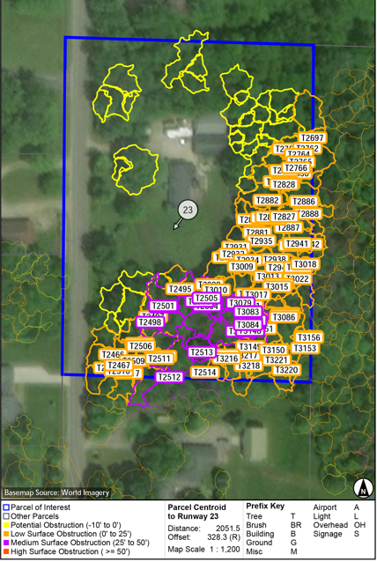
Case Study #3
You are working on an Airport Layout Plan update and have obtained approach obstruction information that shows the airport has obstructions to their primary runway, across numerous surfaces.
What is your responsibility to disclose this information?
Who should you disclose it to?
How quickly?
What else?

Slide 26
Case Study #4
You have completed work on a project that generates recommendations for follow-on work. Should you consider pursuing that work?
Are you allowed by law to pursue it?
Are there actual or perceived conflicts of interest ?
What else might you consider?

Slide 27
Case Study #5
You are at an industry conference reception, talking with someone. They ask you to provide your thoughts on a project they are working on that has not gone well. They want to know how you might have handled it.
What should you say?

Slide 28
Key takeaways
Maintain Confidentiality
Determine who is the client?
Examine what is your professional role?

Slide 29
Questions/discussion Peter J. Kirsch pkirsch@kaplankirsch.com (202) 596-1112

